Slide 1
www.kalgudi.com

Slide 2
about us
decades of ICT for agriculture experience
www.picominer.com
An IOT gateway platform for industrial and agriculture applications
Professional Experience of us
Honeywell, Microsoft, Google, Salesforce, Axis Bank and many more in India, USA, Japan, Australia, UK, Kenya, Ghana,...
www.rofous.com
A content engineering services company. Exited after building 1500 professionals.
2005
2015
2000
2010
Vasudhaika software, focused on agriculture ecosystem
Miniature ERPs, tools and many experiments in agriculture
For agri processing industries.
iAgriMarC
Agriculture marketing platform for mandi in India. Managed few states for 5 years. Over 40B USD transactions handled
kalgudi
Convergence platform for all players in agriculture and allied sectors across the world
Confidential
Notes:
About us.
Focus here is Vasudhaika software, founded in 2001. In Vasudhaika, we work on ICT for agriculture. Started with miniature ERP for agri businesses.
iAgriMarC is an agri produce marketing platform. Few states in India uses it. We handle agri produce valued billions of USD.
Kalgudi is convergence platform that connects everyone in the ecosystem. We started building this over 5 years ago.

Slide 3
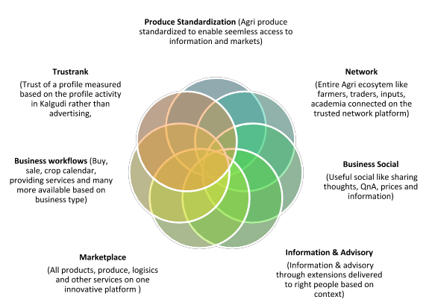
In a nutshell
convergence
Confidential
Notes:
In a nutshell, Kalgudi is a network platform connecting everyone in agri ecosystem across the world.
Core of the platform is a standardized produce that enables easy exchange of information and market data.
Agriculture for us include all allied sectors like horticulture, fisheries,...

Slide 4
Users
for everyone in the ecosystem
create sustainable impact
Informed well and access to market linkages
IMPACT
Donors, Govt, NGO, Universities
kalgudi
CONSUMER
General public, farmers,SHG, FPO
PRODUCER
Farmer, FPO, SHG
BUSINESS
Inputs, services, traders
Get good quality, traceable products
discover markets & win
Confidential
Notes:
Kalgudi has three major groups of users.
Impact
-Govt departments, corporations, donors, NGO, institutions, universities,...
-Key problems solved for them are micro targeting of information, extensions, surveys, digital assistance…
-Kalgudi allows them create a sustainable impact… since the network and marketplace activity created will survive long after impact program is over.
Producer
-Farmers, farmer groups, self help groups, societies,...
-Kalgudi keeps them informed well with relevant, timely & local content
-Since majority of this players do not use marketplaces effectively, Kalgudi creates AI based marketplaces for them.
Business
-Businesses will discover their markets better.Opportunities for them are generated from our anticipatory marketplaces
-Negotiations, transactions, transaction documents and incontext communications further enhance their business workflows
-Contextual traceability helps them to win in their output markets

Slide 5
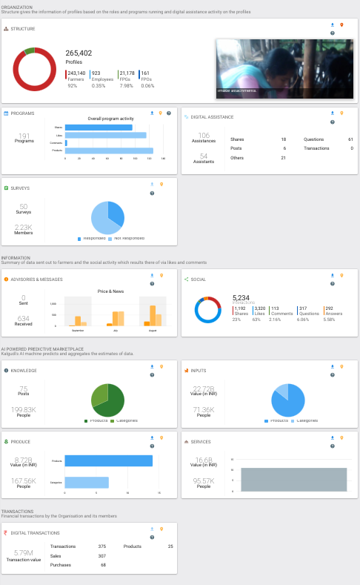
Current status
generating value at scale
3M profiles
1.75M farmers
0.75M women SHGs
0.5M traders & businesses
Social activity hundreds of millions
Marketplace value in Billions
Thousands of B2B Transactions
B2C activity from Nov’18
Confidential
Notes:
Current status of Kalgudi.
Farmers, businesses, self help groups, academia, large corporations…. are on the platform and growing rapidly.
Image shown on the left is a sample dashboard of one of the impact players.

Slide 6
Too good to be true!
challenges at every step
farmers don’t come online!
why would they stay?
who will send right information?
who will answer their questions?
will they use marketplaces?
why will they transact online?
what about trust?
why would businesses be interested?
how can a rural SHG list their product?
can they fulfill online orders?
...
Confidential
Notes:
Self explanatory

Slide 7
Problems solved through
Convergence
Network
Gratification
Transaction duality
Artificial Intelligence
Connecting problems with solutions
& many more innovations
a working model
Ag Depts
Marketplace, Traceability, aggregation, transactions & online payments
Micro targeted & personalized price, weather, pest alerts, FLDs
Other depts
Traders, markfeds, processors, EXIM
NGO
Universities, ICRISAT
Farm IOT &
NGO
Outputs
Info & Advisory
Inputs, equipments, labs, MFI, banks, insurance
Scientists, AOs, Students, Experts
Marketplace, counterfeit, Uberization, banking, financial & insurance
Inputs & Services
Q & A
what to grow, what & how to use, where to sell, how to prevent
Groups
Social
FPO, NGO, Societies
Other farmers, traders, academia
Institutions
ACADEMIA
Pool, distribute, financial, digital assistance, brands & marketing
Contextual interactions, sharing thoughts, ideas, like, social moderation
CORPORATES
Confidential
Notes:
Another view of the platform with farmer at the core.
It is a convergence platform built on gratification model.
Problems are connected with solutions leading to everybody winning.

Slide 8
Info & Advisory
Push advisories
Run extensions
Programs
Surveys
Digital Assistance
every farmer informed well
Ag Depts
Marketplace, Traceability, aggregation, transactions & online payments
Micro targeted & personalized price, weather, pest alerts, FLDs
Other depts
Traders, markfeds, processors, EXIM
NGO
Universities, ICRISAT
Agmarknet, farm IOT &
NGO
Outputs
Info & Advisory
Inputs, equipments, labs, MFI, banks, insurance
Scientists, AOs, Students, Experts
Marketplace, counterfeit, Uberization, banking, financial & insurance
Inputs & Services
Q & A
what to grow, what & how to use, where to sell, how to prevent
Groups
Social
FPO, NGO, Societies
Other farmers, traders, academia
Institutions
ACADEMIA
Pool, distribute, financial, digital assistance, brands & marketing
Contextual interactions, sharing thoughts, ideas, like, social moderation
CORPORATES
Confidential
Notes:
Impact players bring farmers online, runs extensions, advisories, micro-targeting, programs, digital assistance and so on.
Kalgudi also crawls web for relevant information and pushes to the farmers.
Farmer gets targeted, relevant and timely information and advisory.

Slide 9
Social
Question & Answers
Social moderation
Business networks
Gratification
Visibility
Extending reach
social & network effects in action
Ag Depts
Marketplace, Traceability, aggregation, transactions & online payments
Micro targeted & personalized price, weather, pest alerts, FLDs
Other depts
Traders, markfeds, processors, EXIM
NGO
Universities, ICRISAT
Agmarknet, farm IOT &
NGO
Outputs
Info & Advisory
Inputs, equipments, labs, MFI, banks, insurance
Scientists, AOs, Students, Experts
Marketplace, counterfeit, Uberization, banking, financial & insurance
Inputs & Services
Q & A
what to grow, what & how to use, where to sell, how to prevent
Groups
Social
FPO, NGO, Societies
Other farmers, traders, academia
Institutions
ACADEMIA
Pool, distribute, financial, digital assistance, brands & marketing
Contextual interactions, sharing thoughts, ideas, like, social moderation
CORPORATES
Confidential
Notes:
QnA
Questions will get forwarded to the panels of experts.
Machines will classify and respond to duplicate questions with previous answers.
Visibility & social credits helps in getting more people answering questions.
Social activity helps in:
Extending the reach of information
Moderation of content
Network helps in bringing network effects to the ecosystem

Slide 10
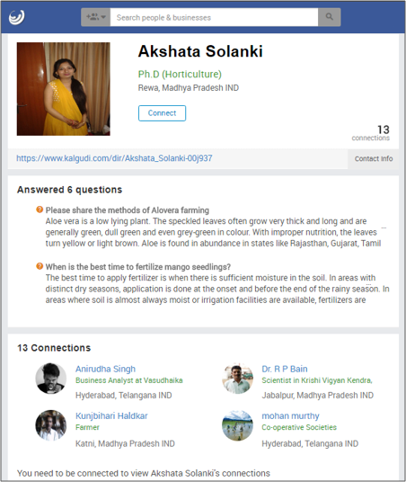
Social credits
A public profile of a student carrying her great work.
helps to answer questions at scale
Confidential
Notes:
QnA
Questions will get forwarded to the panels of experts.
Machines will classify and respond to duplicate questions with previous answers.
Visibility & social credits helps in getting more people answering questions.
Social activity helps in:
Extending the reach of information
Moderation of content
Network helps in bringing network effects to the ecosystem

Slide 11
FPO
Pool
Merge
Demand & supply aggregations
Sell/purchase
Distribute
Financial accounts
Information push
Get visibility
large farming benefits to small holding farmers
Ag Depts
Marketplace, Traceability, aggregation, transactions & online payments
Micro targeted & personalized price, weather, pest alerts, FLDs
Other depts
Traders, markfeds, processors, EXIM
NGO
Universities, ICRISAT
Agmarknet, farm IOT &
NGO
Outputs
Info & Advisory
Inputs, equipments, labs, MFI, banks, insurance
Scientists, AOs, Students, Experts
Marketplace, counterfeit, Uberization, banking, financial & insurance
Inputs & Services
Q & A
what to grow, what & how to use, where to sell, how to prevent
Groups
Social
FPO, NGO, Societies
Other farmers, traders, academia
Institutions
ACADEMIA
Pool, distribute, financial, digital assistance, brands & marketing
Contextual interactions, sharing thoughts, ideas, like, social moderation
CORPORATES
Confidential
Notes:
An individual farmer needs might be too small for businesses to notice!
Kalgudi aggregates farmer needs at a group/society level. This is first point of aggregation of needs and also a delivery point for information, since most of the farmers are passive.
A group has its unique needs too. Kalgudi helps them with:
Pooling produce, merging, selling, buying, distribution, their financial accounts, marketing, visibility...
A group also gets its own dashboard that they can use to showcase their activities!
With their basic operational problems solved, group responds to aggregated needs.

Slide 12
Marketplaces & transactions
AI marketplaces
Knowledge
Inputs
Services
Outputs
Dynamic aggregation
Transaction duality
Rich traceability
Sell online
efficient marketplaces even for passive farmers
Ag Depts
Marketplace, Traceability, aggregation, transactions & online payments
Micro targeted & personalized price, weather, pest alerts, FLDs
Other depts
Traders, markfeds, processors, EXIM
NGO
Universities, ICRISAT
Agmarknet, farm IOT &
NGO
Outputs
Info & Advisory
Inputs, equipments, labs, MFI, banks, insurance
Scientists, AOs, Students, Experts
Marketplace, counterfeit, Uberization, banking, financial & insurance
Inputs & Services
Q & A
what to grow, what & how to use, where to sell, how to prevent
Groups
Social
FPO, NGO, Societies
Other farmers, traders, academia
Institutions
ACADEMIA
Pool, distribute, financial, digital assistance, brands & marketing
Contextual interactions, sharing thoughts, ideas, like, social moderation
CORPORATES
Confidential
Notes:
Kalgudi uses farmer profile, ecological information, local crop calendars, QnA, advisory and so on to generate farmer’s needs.
These needs are appropriately aggregated and pushed to businesses like inputs, services, outputs….
From the marketplaces, Kalgudi takes businesses to transactions, traceability, financial accounts,...

Slide 13
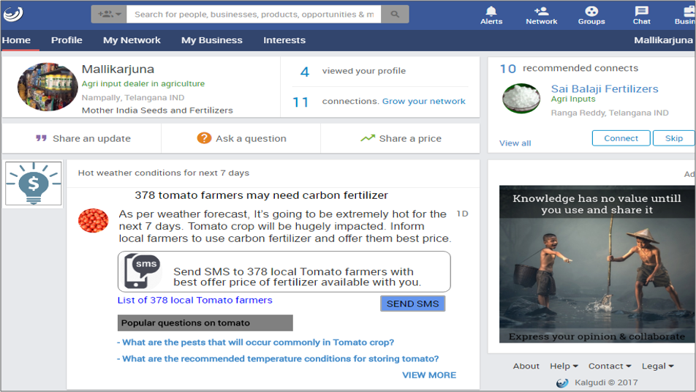
connecting problems with solutions
Confidential
Notes:
Kalgudi uses farmer profile, ecological information, local crop calendars, QnA, advisory and so on to generate farmer’s needs.
These needs are appropriately aggregated and pushed to businesses like inputs, services, outputs….
From the marketplaces, Kalgudi takes businesses to transactions, traceability, financial accounts,...

Slide 14
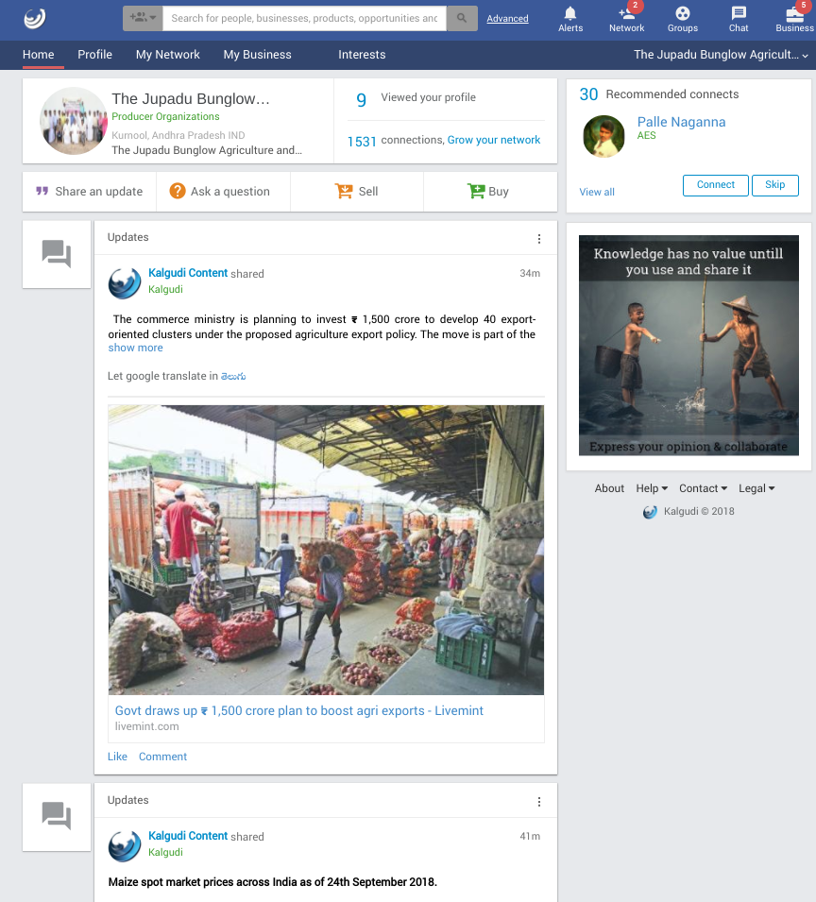
Kalgudi is their own...
facebook+linkedIn+alibaba of farmers!
business network, discovery, marketing & mini erp for entrepreneurs
delivery platform for impact players
agri e-commerce store for consumers
Confidential
Notes:
This is how different players sees the system.

Slide 15
An NGO, to increase 1600 ginger farmers income by 15% in 2 years, funded by a donor
Digitize & Structure
Social & Knowledge
Marketplaces
Transactions
Bring farmers online
Profiling
Geofencing
Build networks
Dashboard
Donor access
Visibility
Push information
Review AMP & respond
Answer questions
Tie up with academia
Be social & encourage
Every farmer informed
Socially active
Review AMP
Create posts
Respond to others
Aggregate & promote
Buyer-seller meets
All needs in marketplaces
Facilitate negotiations
Encourage transactions
Collaborative commerce
Integrate other services
Convergence
Sustainable Impact
Confidential
Notes:
An example of how an Impact player uses Kalgudi to create sustainable impact in agriculture domain.
Some other examples in impact players include:
-Contract farming
-Seed multiplication
-FLD
-Large farmer groups
-...

Slide 16
A business selling crop protection products to farmers/fpo
Transact and support
Farmers/FPO accounts reflect the transactions. Support with literature, how to use and others.
Setup store
Product listing, API to respond with brands, plan targets, promotions
04
01
03
Build trust
Be social, answer questions, share thoughts, report transactions, respond to customers quickly,...
Ready with responses
Expect Kalgudi to ask brands and offers available for a problem or advisory and respond quickly.
02
Confidential
Notes:
This is for businesses for which farmers are customers.
Key here is step 3:
Business need to profile themselves well so that platform can create opportunities for them.
Loans aspect of the Bank you were talking falls in this category. Instead of same organization doing both, I suggest consider impact activity and this separate. This could be the loans division of the same bank.

Slide 17
A business exporting agriculture produce bought from farmer/fpo
Export
Reachout to markets with contextual traceability. Quality produce while taking care of farmer’s quality of life.
4
Process
Collaborate with players involved in supply chain systems and report key process elements.
3
Procure
Use AMP to plan, post for bigger reach, negotiate and procure.
2
Manage & support suppliers
Bring them online, inform them well, build trust, address their questions, support their supply lines...
1
Confidential
Notes:
This is for businesses for which farmers are suppliers.
Applicable for businesses like exporters, processors, manufacturers,..
Key here is to integrate farmers and their own systems to get contextual traceability.

Slide 18
A self help group selling agri products direct to consumer
Lorem 2
Promotions
Lorem 3
Orders
Lorem 4
Fulfillment
Lorem 5
Lorem 1
Settlements
Product Listing
Products are listed automatically in Kalgudi from standardized products available.
Seller simply selects products and adds specific images and information.
Products listed are indexed by search engines.
Sellers are promoted to their potential Customers as well as to their suppliers.
Traceability automatically generated is one of the key promotion.
Multiple modes of orders are enabled: Buy now, Customize, & Subscribe.
Kalgudi enables a collaborative environment where seller can take services from packers, transporters, and other players on demand and fulfill.
All settlements are through bank’s escrow services based on services taken by seller in fulfilling an order.
collaborative e-commerce for the bottom of the pyramid
Confidential
Notes:
A farmer, group or a business sells agri products direct to consumer.
A farmer group selling mangoes, a self help group selling snacks, a small processor selling sweets… Kalgudi enables collaborative commerce for these.
This is an innovative rural e-commerce model. Will be launched in few weeks.

Slide 19
How does Kalgudi make money?
no ads, no selling data or reports, no promotions based on fees….
no doing evil
Activity | Cost
Producer (Farmer, FPO, SHG,Universities, Govt departments, ..) | FREE
Impact as a service (Donors, NGO,...) | INR 12/-, per farmer per year
Market linkage services | INR 50,000/- per month for up to 25000 farmers
B2B (Inputs, services, outputs,..) | 2% + bank charges Seller pays on transactions
B2C | 5% + bank charges Seller pays on transactions
Opportunity fee (optional) | Dynamic pricing based on value of the opportunity. Upto INR 750/- for a set of leads. Business pays when taken.
Confidential
Notes:
This is how different players sees the system.

Slide 20
How does Kalgudi make money?
no ads, no selling data or reports, no promotions based on fees….
no doing evil
Activity | Cost
Producer (Farmer, FPO, SHG,..) | FREE
Impact as a service (Universities, Donors, NGO, Govt departments,...) | INR 12, per farmer per year
Market linkage services | INR 50000 per month for up to 10000 farmers
B2B (Inputs, services, outputs,..) | 2% + bank charges Seller pays on transactions
B2C | 5% + bank charges Seller pays on transactions
Opportunity fee (optional) | Dynamic pricing based on value of the opportunity. Upto INR 750 for a set of leads. Business pays when taken.
Note - Fee is region specific and subjected to revision
Confidential
Notes:
This is how different players sees the system.

Slide 21
thank you
Sreekanth.voleti@kalgudi.com

